Slide 1


Project: Health Insurance Claim Business Report
Kalidindi Sreeram Chaitanya Varma
GLCA DA Academic Project

Slide 2
Business Problem
“Finding out the health parameters that affect health insurance claims”
An insurance company in the US is reviewing its insurance claims/charges and is trying to do a cause-and-effect analysis for future business decisions. It has collected data for its customers who have made claims in recent times. The data points collected are age, gender, BMI, number of children/dependents, smoking habit, the region they belong to, and charges/bills claimed under the insurance. This analysis would have a bearing on what premium should the company charge a customer availing an insurance policy.

Slide 3
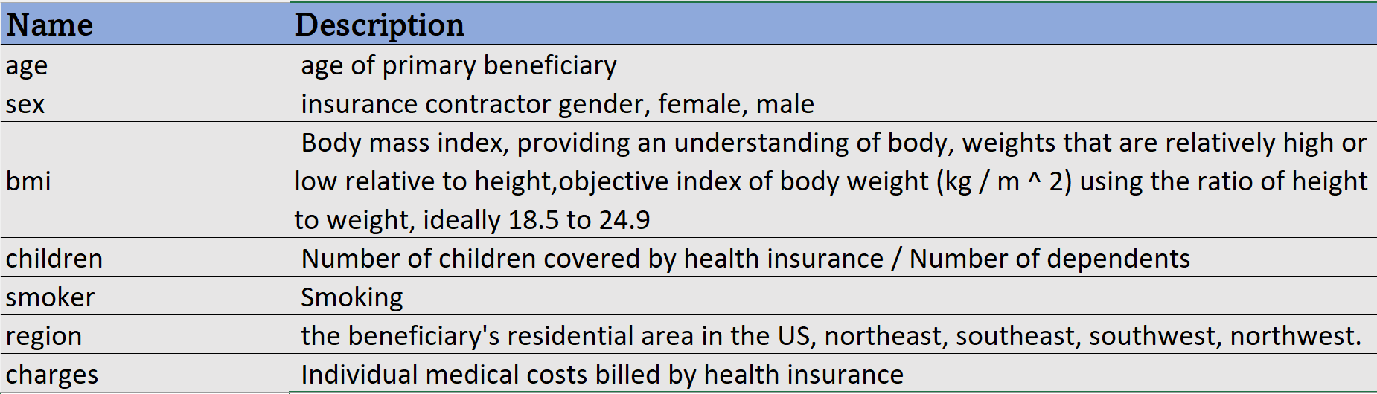
Data Description

Slide 4
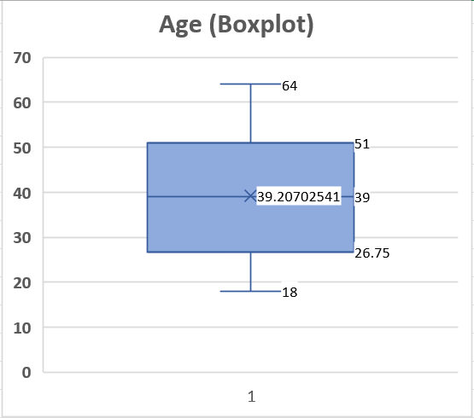
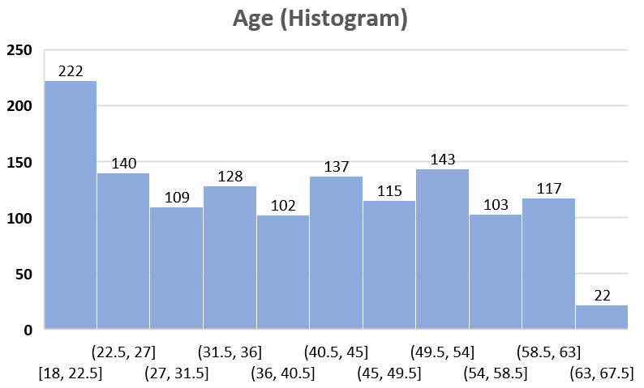
Univariate Analysis of Numerical Variable
Age; Box Plot and Histogram

Slide 5
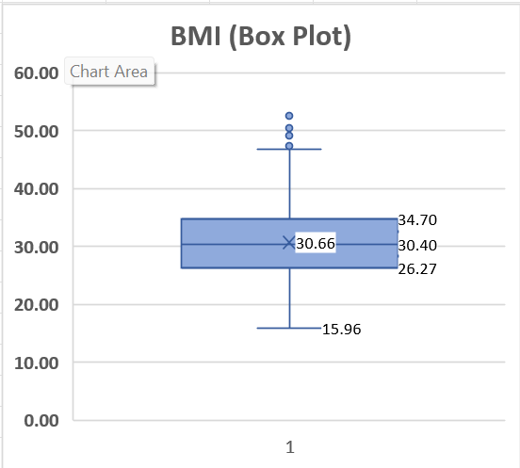
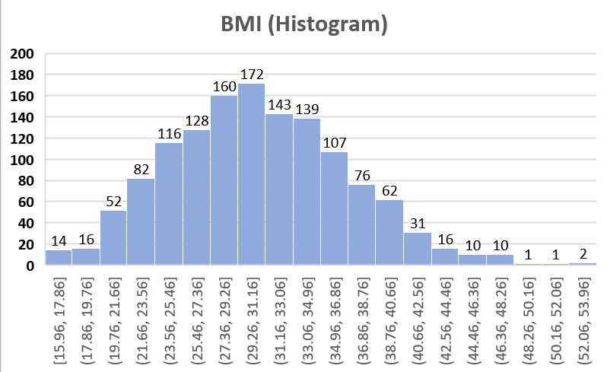
Univariate analysis of BMI
BMI; Box Plot and Histogram

Slide 6
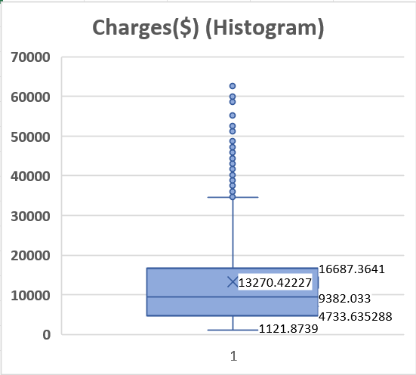
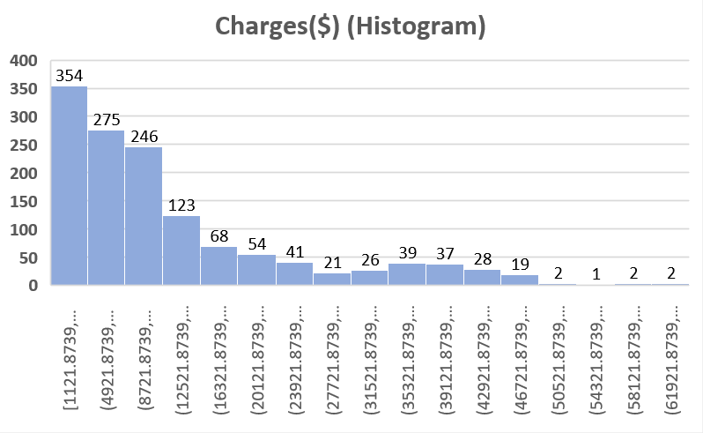
Univariate Analysis of Charges
Charges($); Box Plot and Histogram

Slide 7
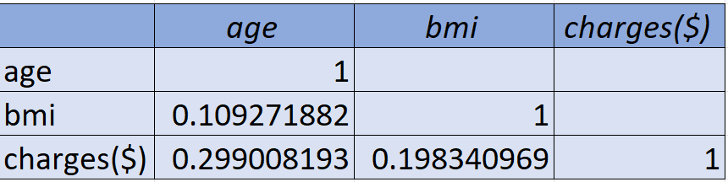
Multivariate Analysis (Correlation)
Correlation analysis of variables Age, BMI and Charges($). We see a weak positive correlation between age and charges($).

Slide 8
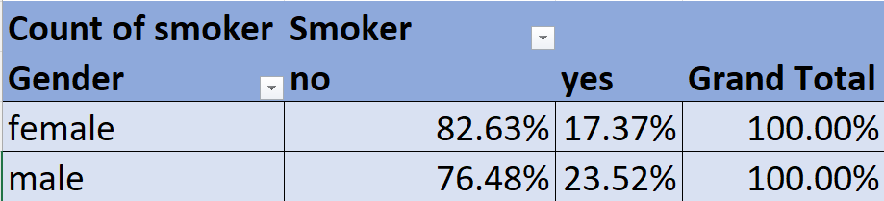
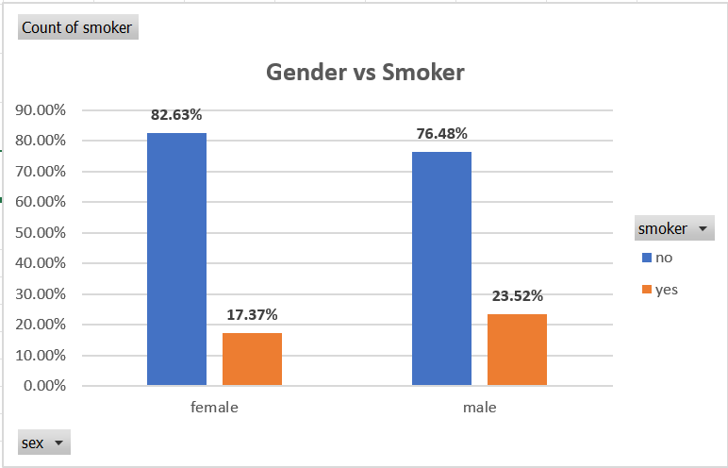
Gender Vs Smoker
Observation
The customer data contains 662 females and 676 males.
The number of female smokers (115) is less than compared to the number of male smokers(159).
About 17.37% of female customers are smokers, while about 23.52% of male customers are smokers.

Slide 9
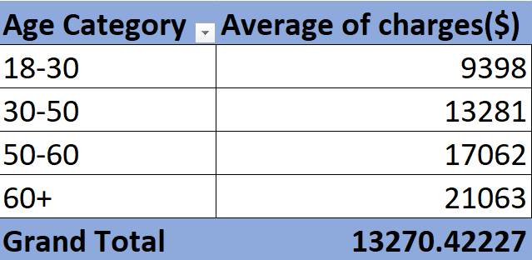
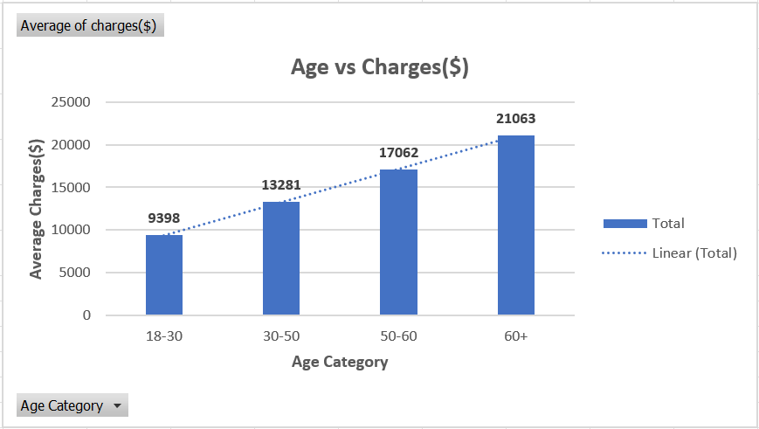
Age vs Charges
Observation:
We can see that as the age of the customer increases the charges increase linearly.

Slide 10
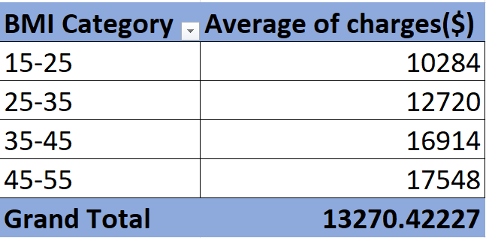
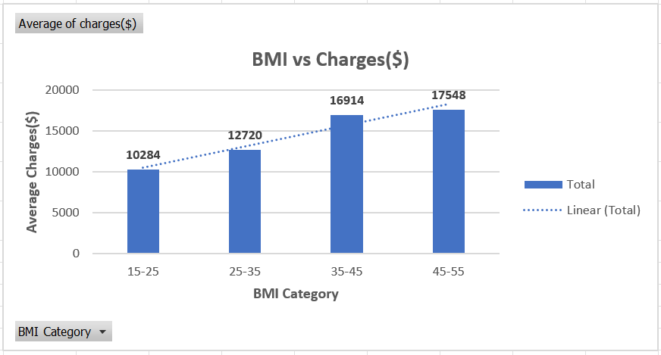
BMI vs Charges($)
As the BMI of customers increases the charges increase linearly.

Slide 11
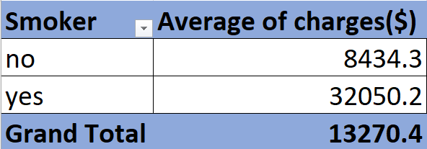
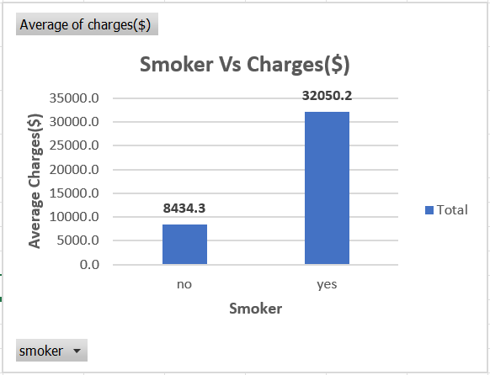
Smoker vs Charges($)
Observation:
We see that the average charge for a customer who smokes is 3.8 times more than the charges of the customers who do not smoke.

Slide 12
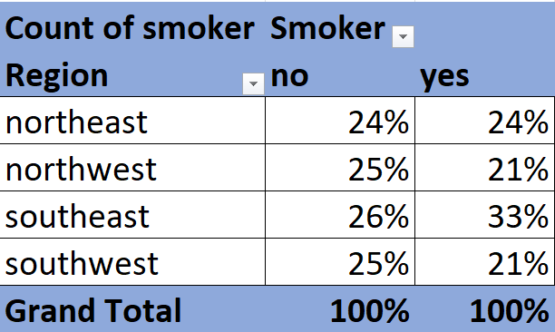
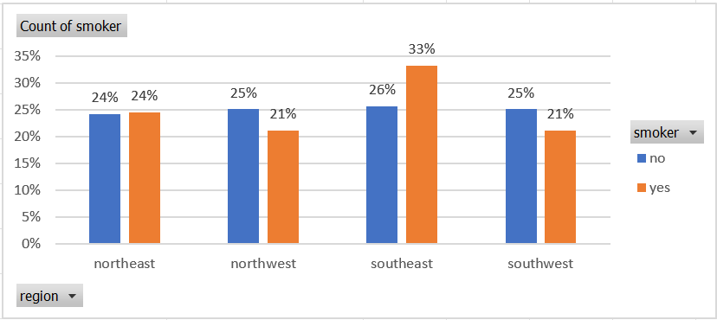
Region Vs Smoker
About 1/3rd of all the customers in the data who smoke are from the region of Southeast.

Slide 13
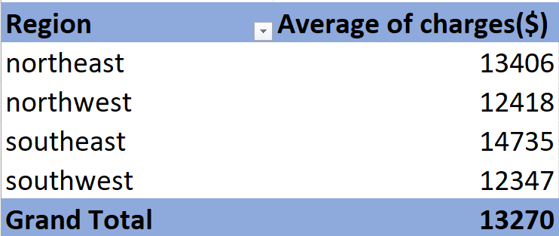
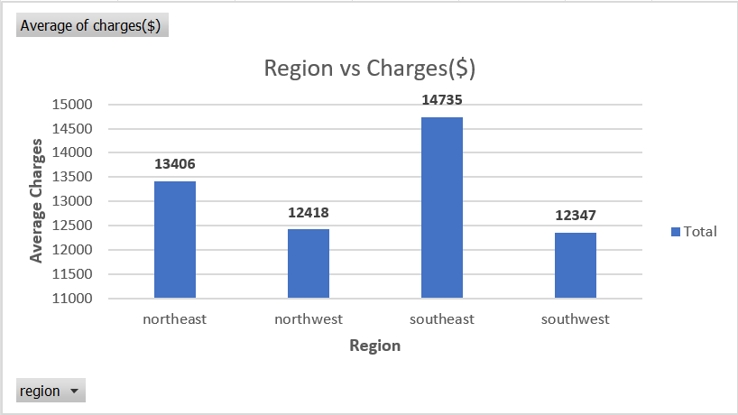
Region vs Charges($)
Southeast having higher average charges than other regions makes sense because we saw that the number of smokers in that region is higher compared to other regions

Slide 14
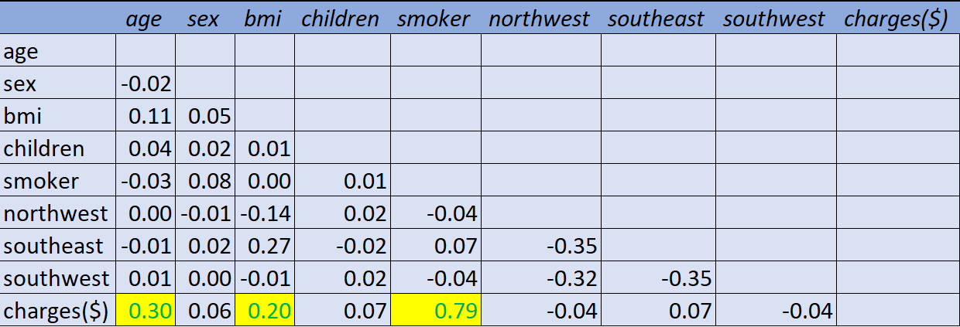
Correlation Analysis of treated data
After treating the data and converting categorical variables into numerical ones. We perform a correlation analysis.
We find that Smoker, BMI and Age are the three most important variables that determine the charges($) paid by a customer.

Slide 15
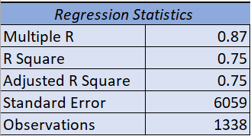
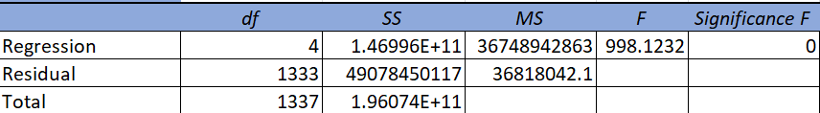
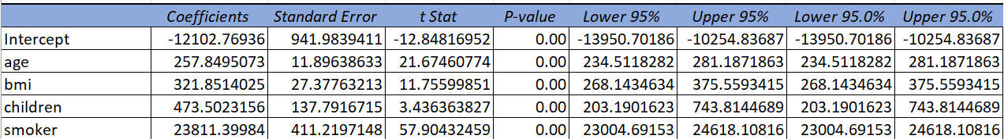
Multilinear Regression Analysis
We did a Multilinear regression analysis to identify variables that decide the insurance charges/billed insurance claim.
The multiple R-value is 0.87, which means that about 87% of the variability in the target variable (Charges($)) can be explained by the independent variable.
But we found variables with a p-value of more than 0.05, so we removed them and did the regression analysis again.
The most significant variables that decide the insurance charges are Age, BMI and Smoker.

Slide 16
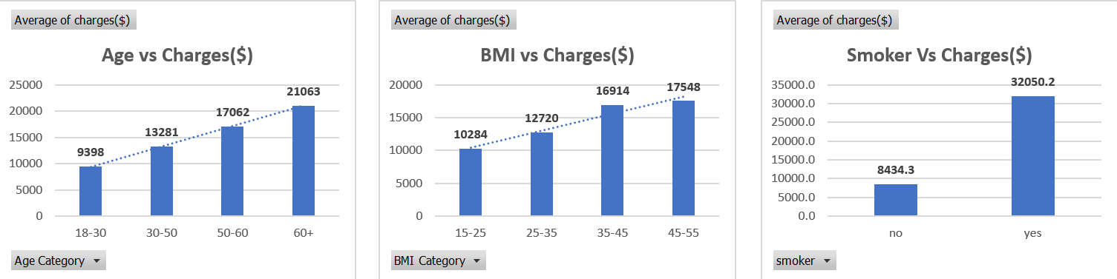
Health Parameters that Affect the Insurance Claim
Age, BMI and Smoker

